Slide 1


Unity 3D Course
Lection 6.Animations & Audio

Slide 2
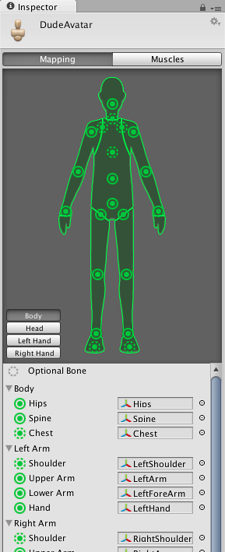
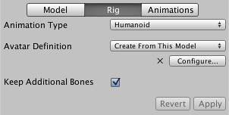
Animations
Lection 6. Animations & Audio
Import Animations
Avatars
Rig
Animation window
Animation clips
Notes:
http://docs.unity3d.com/Manual/AnimationsImport.html
http://docs.unity3d.com/Manual/class-AnimationClip.html
Explain avatars and Rig
Show simple animation clip and how to play it using C#
Show how to make your own animation using Animation window
Show from sprite frames to walking animation in the editor using the Dumpy charachter

Slide 3
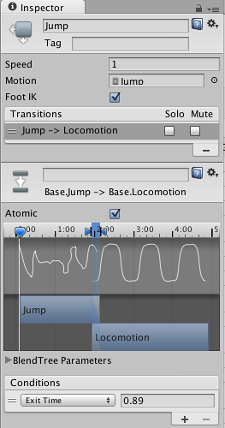
Manage Animations
Lection 6. Animations & Audio
Animator Window
Animation States
Blend Animations/Transitions
Animation Inspector Settings
Notes:
Show animator and how to add transitions.
Show Animation states
Also explain transition window and adjust few transitions
http://docs.unity3d.com/Manual/class-AnimationClip.html
http://docs.unity3d.com/Manual/class-Transition.html
Scripting- Show them how to control which state is playing and how to make an animation system with array and Enum
Tell them about changing speed changes all states speed and how sample rate from Animation window can help changing speed for one state

Slide 4
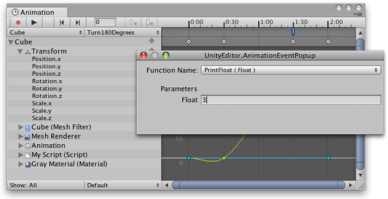
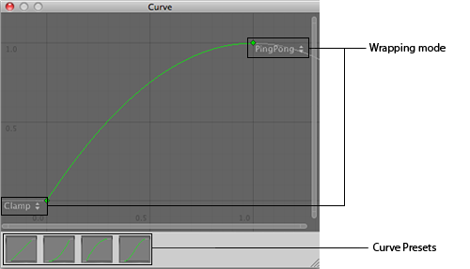
Advanced
Lection 6. Animations & Audio
Using Animation Events
Animation Clip Event
Animation Event
Using Animation Curves
Blend Trees
Notes:
Show how to add event using editor and using Timer in C#
When to use events – for example when collider needs to be adjusted or something that should occur in the middle of the animation…
Show both types of events – For Animations made in Unity where method is dropped down from list and when you are declaring event in the imported animation settings
When to sue curves- when for example you are monitoring for some point at the animation or let’s jump height…or when the foot of a character is down on the ground
http://docs.unity3d.com/Manual/class-BlendTree.html
http://docs.unity3d.com/Manual/EditingCurves.html
http://www.kwalee.com/2012/10/26/unity-3d-animation-curves-explained/

Slide 5
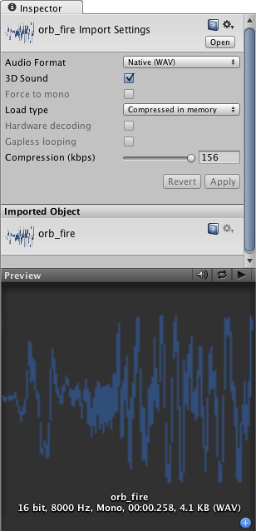
Audio
Lection 6. Animations & Audio
Audio sources
Audio Listener
Audio Clip import settings
Notes:
http://docs.unity3d.com/Manual/class-AudioClip.html
http://docs.unity3d.com/Manual/class-AudioSource.html
Play example audio clip with or without audio source.
Explain every property of the import settings

Slide 6
Useful links
Lection 6. Animations & Audio
http://docs.unity3d.com/Manual/AnimationsImport.html
http://docs.unity3d.com/Manual/ConfiguringtheAvatar.html
http://unity3d.com/learn/tutorials/modules/beginner/animation
http://docs.unity3d.com/Manual/class-AnimationClip.html
http://docs.unity3d.com/Manual/EditingCurves.html
http://docs.unity3d.com/Manual/AnimatorCurves.html
http://docs.unity3d.com/Manual/class-BlendTree.html

